Slide 1


Advanced Gluttonous Snake
Slytherin
Shanshan zhao
Liyi cao
Yujia wang
Yinzhu Su
http://tech.sina.com.cn/roll/2017-07-21/doc-ifyihrwk1647246.shtml

Slide 2

Goal of the project. What are you trying to do?
We are trying to build a video game based on FPGA and Verilog.
Our first thought of the video game is Gluttonous Snake.
Easy to control. Low hardware requirement. Only need few external devices.
But it might be too simple.
ADVANCED Gluttonous Snake.
https://cn.technode.com/post/2017-10-13/razer-phoneleak-8gb-ram/

Slide 3
Why this is an interesting project? Why should we care about this?
http://www.cnblogs.com/bantina/p/5680080.html
http://games.ifeng.com/a/20170216/44543884_1.shtml
https://cn.technode.com/post/2017-10-13/razer-phoneleak-8gb-ram/
https://cn.technode.com/post/2017-10-13/razer-phoneleak-8gb-ram/

Slide 4
Why this is an interesting project? Why should we care about this?
More Snakes
Enemies
Food
Function
Battle
Play with your friend!
https://cn.technode.com/post/2017-10-13/razer-phoneleak-8gb-ram/
https://cn.technode.com/post/2017-10-13/razer-phoneleak-8gb-ram/

Slide 5
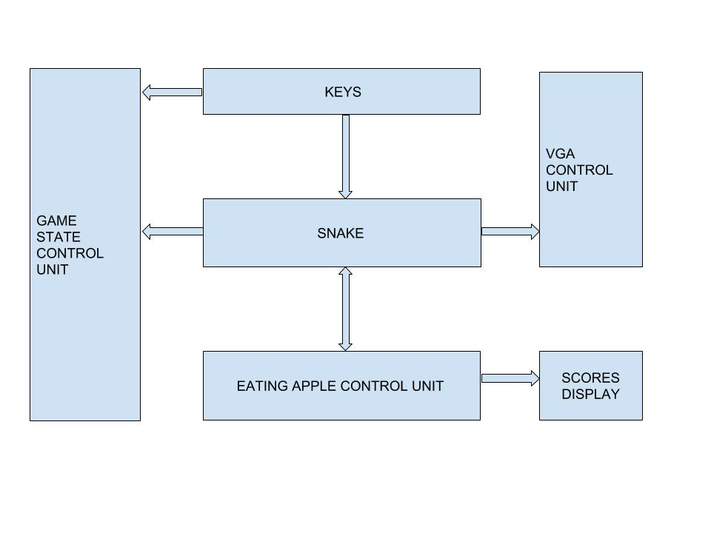
HIGH level diagram of how the system is going to work.
https://cn.technode.com/post/2017-10-13/razer-phoneleak-8gb-ram/
https://cn.technode.com/post/2017-10-13/razer-phoneleak-8gb-ram/

Slide 6
Walk us through a how you will demo the system. How will your prove it is working?
Demo by recording a video.
Demo face by face.
Welcome to try our Advanced Gluttonous Snake!
https://cn.technode.com/post/2017-10-13/razer-phoneleak-8gb-ram/

Slide 7
What do you need to make this work? Hardware and software needs. Do you have all of this? How are you going to get it? Do you need money for supplies? How much?
FPGA board
VGA Displaying Control Module
MicroBlaze CPU
Display Screen
*External SRAM
Verilog ISE
Embedded Development Kit
Hardware
Software
https://cn.technode.com/post/2017-10-13/razer-phoneleak-8gb-ram/

Slide 8
Biggest worries and backup plan in the event that things don’t work out.
Assuming the entire screen scanning mode is 640 * 480 , it might be complex and hard to operate if we directly use pixels to represent the various parts of the game.
If we can’t realize the scanning on the entire screen since there are too many pixels， we would decrease the resolution by using a 16 * 16 pixel range to represent a grid, and then scan the entire screen in grid units.
https://cn.technode.com/post/2017-10-13/razer-phoneleak-8gb-ram/

Slide 9
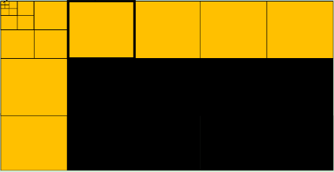
Biggest worries and backup plan in the event that things don’t work out.
https://cn.technode.com/post/2017-10-13/razer-phoneleak-8gb-ram/

Slide 10
Timeline and project assignments
1st 2-weeks VGA displaying via FPGA
2nd 2-weeks Building basis game frame
3rd 2-weeks Make the game ADVANCED
4th 2-weeks Battle System
Shanshan Zhao VGA display
Liyi Cao Testing Game
Yujia Wang Basic Game Frame
Yinzhu Su Specific Game Function
https://cn.technode.com/post/2017-10-13/razer-phoneleak-8gb-ram/

Slide 11
Thank You！
https://cn.technode.com/post/2017-10-13/razer-phoneleak-8gb-ram/

